Slide 1
Ai enabled smart sewer safety & predictive hazard monitoring system
Team members:
1. kiran.M -31024106099
2. Kaviya.R -31024106096
3. Bebith Joseph -31024106602
4. Harivignesh K.S -31024106065
5. Harrshetha Pradeep -31024106066
6. Lakshmi Narayanan.V -31024106106

Slide 2
Introduction
Sewer systems are a critical part of urban infrastructure. However, sewer maintenance is one of the most dangerous occupations due to toxic gases, oxygen deficiency, and structural hazards. Many accidents occur because workers enter manholes without real-time environmental monitoring.
An AI Enabled Smart Sewer Safety & Predictive Hazard Monitoring System is designed to monitor sewer conditions in real time, detect hazardous gases, predict dangerous situations using Artificial Intelligence (AI), and prevent accidents before they happen.

Slide 3
Problem StatementManual sewer inspection involves:
Exposure to toxic gases like Hydrogen Sulfide (H₂S)Methane gas accumulationOxygen deficiencyRisk of explosionSudden floodingStructural collapse
No continuous monitoring.
No early warning system.
Human-dependent safety checks.
Lack of predictive analysis
Delayed emergency response.

Slide 4
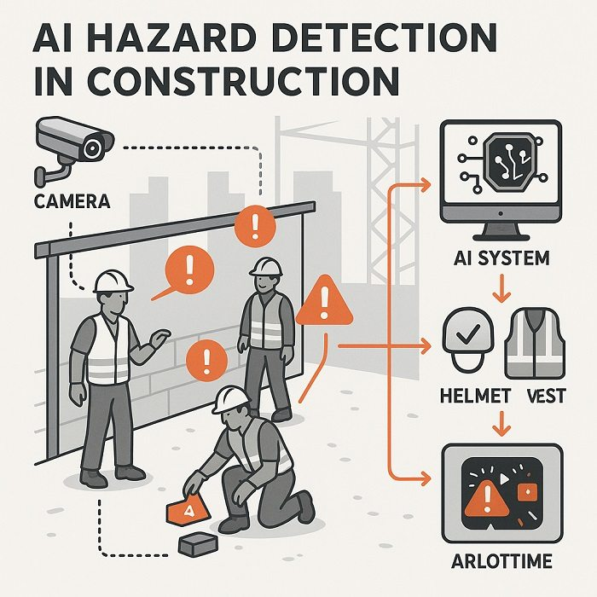
Objectives
The main objective of this system is to ensure worker safety and prevent sewer hazards. It aims to detect toxic gases, monitor water levels, predict blockages, reduce manual inspection, and provide real-time alerts to authorities.

Slide 5
System Architecture
The hardware includes gas sensors (H₂S, CH₄, CO), ultrasonic water level sensor, temperature sensor, Arduino/Raspberry Pi, and communication module.
The software includes a cloud database, machine learning algorithms, anomaly detection models, and a web/mobile dashboard.
The system consists of three layers:
Sensor Layer – Gas, water level, and temperature sensors collect data.
Communication Layer – IoT modules transmit data to the cloud.
AI Processing Layer – Machine learning algorithms analyze data and generate alerts via a dashboard.

Slide 6
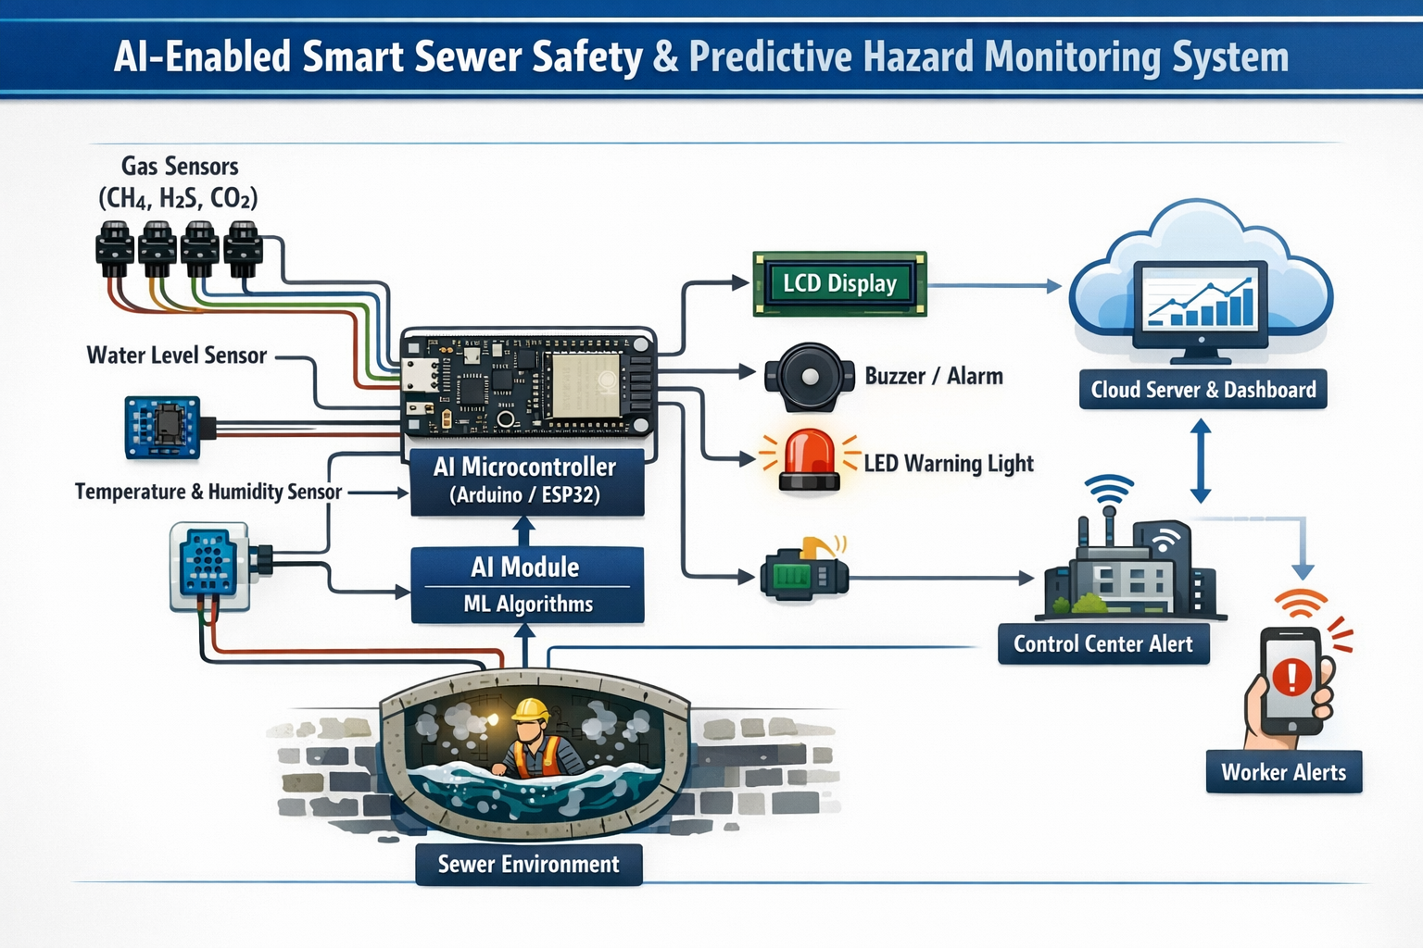
Circuit diagram

Slide 7
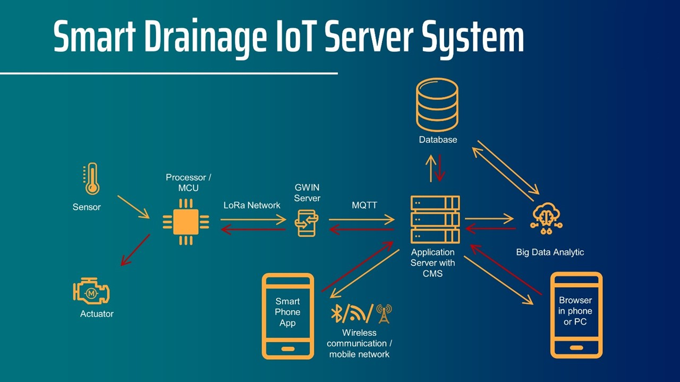
Key Features & Predictive Monitoring
The system provides real-time gas detection, overflow monitoring, remote dashboard access, automated alerts, and predictive maintenance. AI analyzes historical data to forecast blockages and infrastructure failure before they occur.

Slide 8
Disadvantage:
Advantage & Disadvantage
Advantages:
Disadvantage:
Improves Worker Safety
Detects harmful gases (CH₄, H₂S, CO₂) and alerts workers before entering dangerous zones.
Early Hazard Prediction
AI analyzes trends to predict floods, toxic gas buildup, or equipment failure in advance.
Remote Access
Engineers can monitor sewers from control rooms or mobile apps.
Cost Effective in Long Term
Reduces medical costs, accidents, and emergency maintenance.
High Initial Cost
Sensors, AI modules, cloud servers, and installation are expensive.
Maintenance Required
Sensors may fail due to water, dirt, corrosion, or bio-waste.
Power Dependency
Needs reliable power or battery backup in underground areas.
Network Issues
Internet or wireless signals may be weak inside sewers.

Slide 9
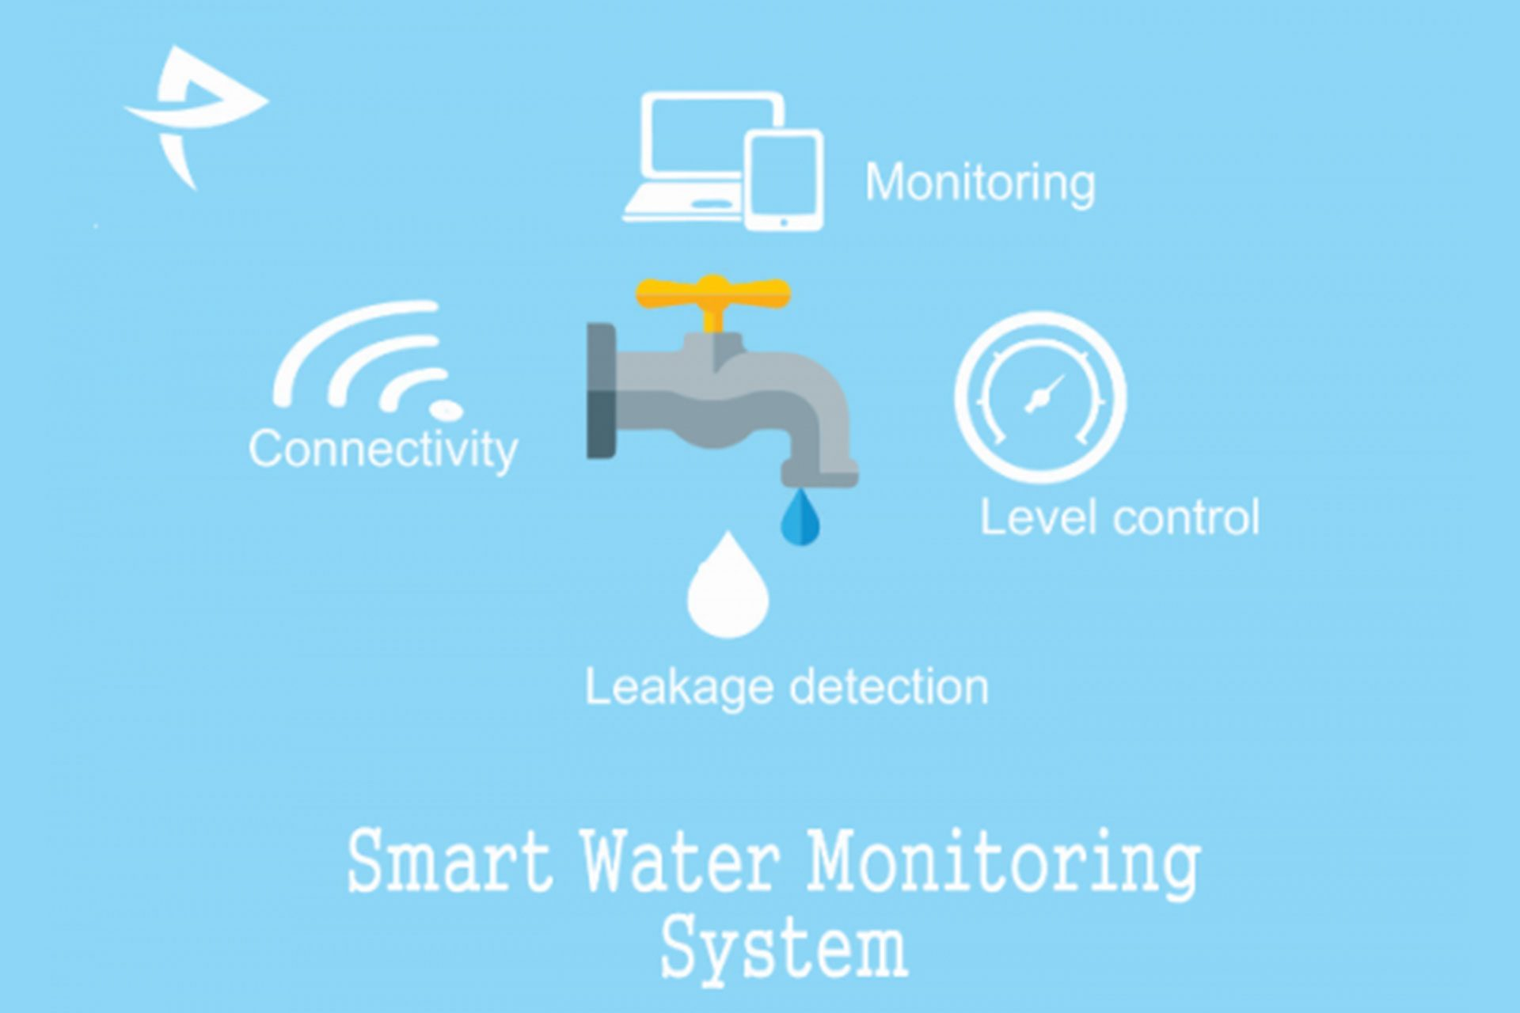
Conclusion & Future Scope
The AI-enabled smart sewer monitoring system provides a safe, intelligent, and efficient solution for urban sanitation challenges. Future enhancements may include AI-powered sewer robots, digital twin technology, and integration with smart city platforms.

